Slide 1


INFO-C451 Project
Project Demo

Slide 2
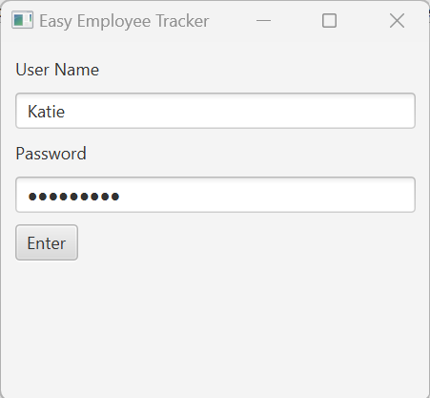
User Log on Screen
Authenticates username and password.
If username and password is invalid, error
message displays.

Slide 3
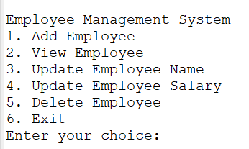
Menu Displays
Select number next to function
you would like to perform.

Slide 4
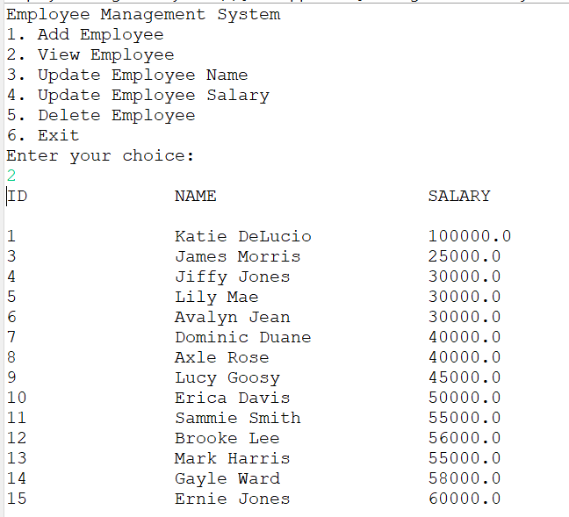
View List of Employees
Selection (2) View Employee provides
a list of employees and corresponding
information stored in the database.

Slide 5
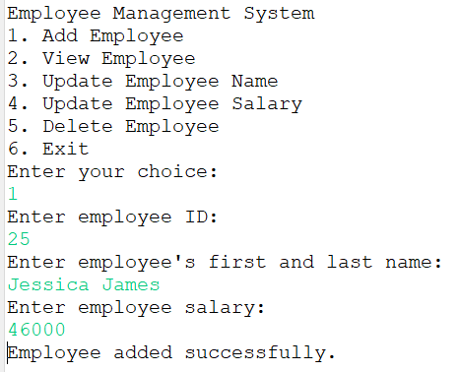
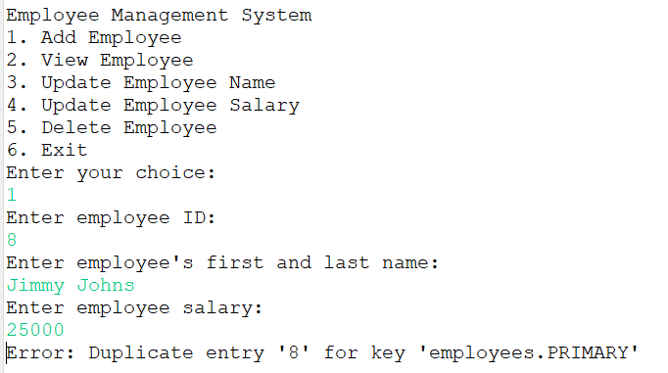
Add New Employee
Selection (1) Add Employee. Add new employee
information. Error occurs if employee ID is not
unique as this is primary key on employee
database

Slide 6
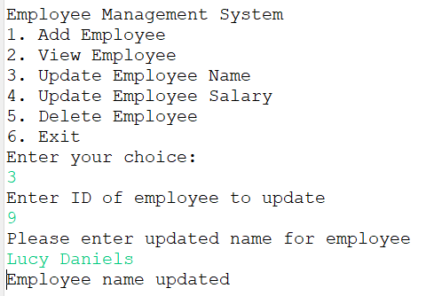
Update Employee Name
Selection (3) Update Employee
Name. Function can be used to
change name on record for employee,
like in the case of name change
due to change in marital status.

Slide 7
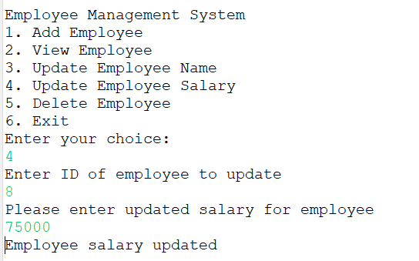
Update Employee Salary
Selection (4) Update Employee
Salary. Function used to update
salary on employee record in the case
of a raise or change in job status.

Slide 8
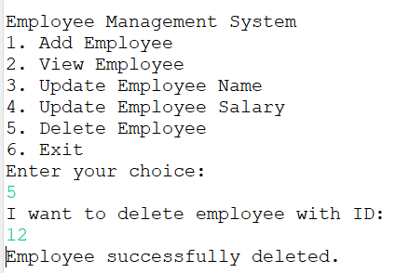
Delete Employee
Selection (5) Delete Employee.
Function is used to delete employee
record from database. Used in event of
employee termination.

Slide 9
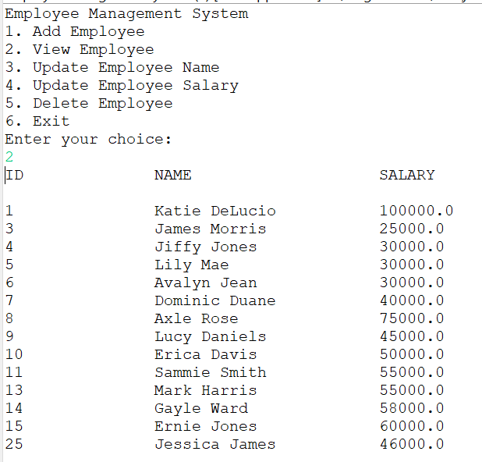
All Changes Saved on Database
Employee 25 was added to database. Employee 9 had a last name change.
Employee 8 had a salary change. Employee 12 was deleted from database.
Before changes
After changes

Slide 10
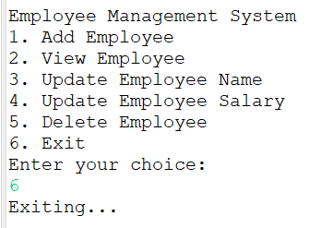
Exit the System
Selection (6) Exit. Exits the system.

